Slide 1

Computing components
Lesson 1: Measuring computer performance
Computer Peripherals

Slide 2
Objectives
In this lesson, you will learn how to:
Identify computer peripherals (input, output, and storage devices).
Explain how data is input, processed, and output in a computer system.
Order and compare storage units (bit, byte, kilobyte, etc.) and speed units (hertz, megahertz, gigahertz, etc.).
Justify the choice of computer hardware based on performance needs.

Slide 3
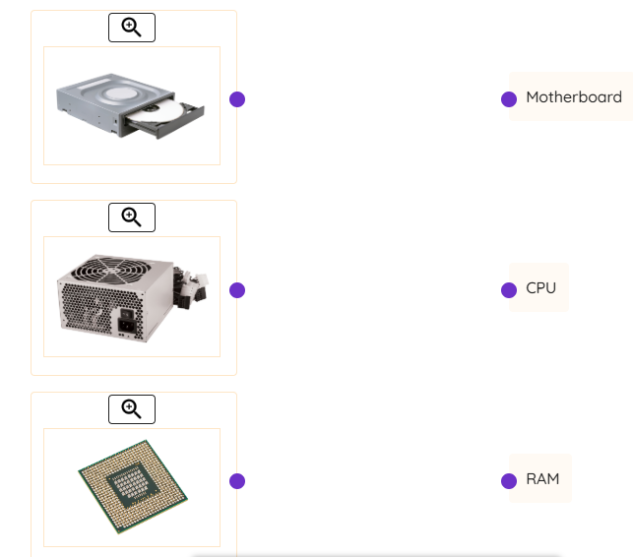
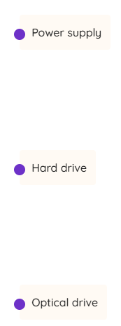
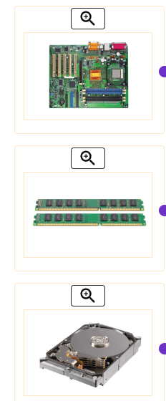
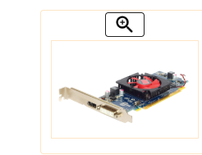
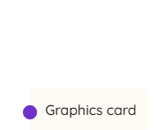
Activity 2.1: Match correct device names

Slide 4
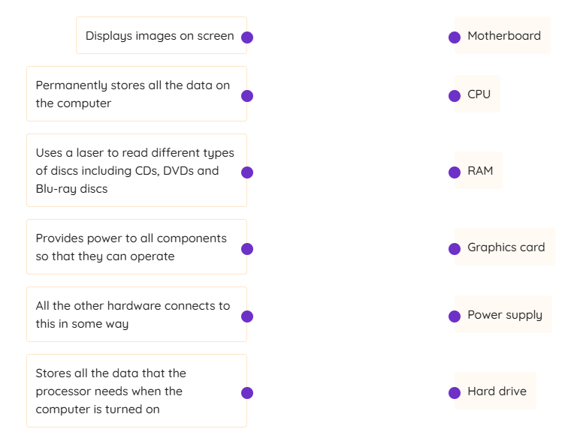
MATCH correct explanations

Slide 5
Measuring performance
Hardware components do different things and so their performance is measured in different ways using different units.
CPU performance is measured by its clock speed (hertz). This is how many fetch–decode–execute cycles the CPU can process per second and is often referred to as just ‘speed’.
RAM performance is measured by its speed (hertz) and how much it can store (bytes).
Hard drive performance is measured by how much it can store (bytes).

Slide 6
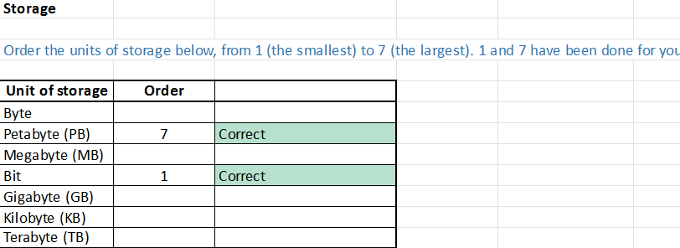
Activity 2.2: Measuring performance

Slide 7
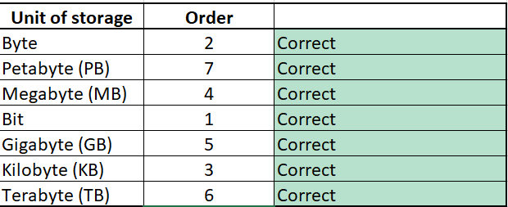
Answers

Slide 8
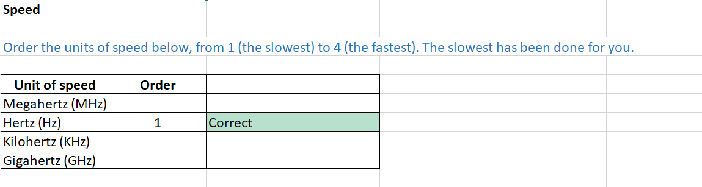
Activity

Slide 9
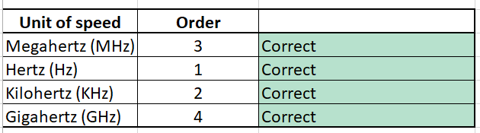
Answers

Slide 10
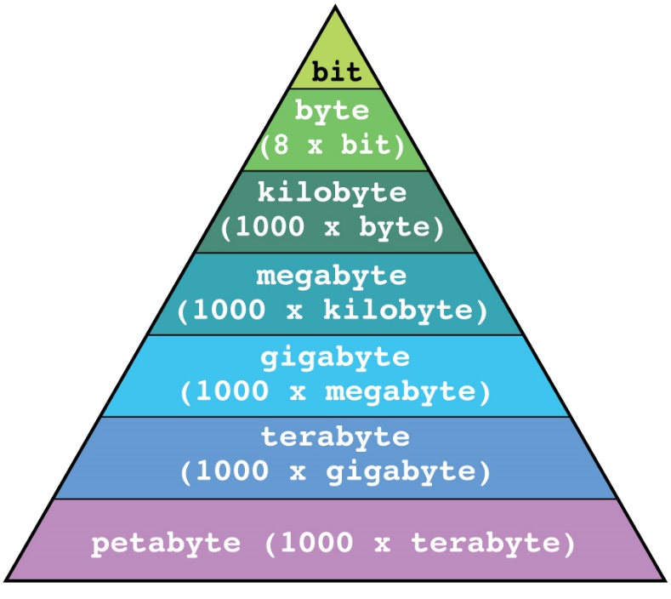
Converting units of storage
You can convert different units of storage so you can compare the performance of different hardware.
1 terabyte = 1,000 gigabytes = 1,000,000 megabytes (1000 x 1000)
2 terabytes = 2,000 gigabytes = 2,000,000 megabytes (2 x 1000 x 1000)
1,000,000 kilobytes = 1,000 megabytes = 1 gigabyte
4,000,000 kilobytes = 4,000 megabytes = 4 gigabytes

Slide 11
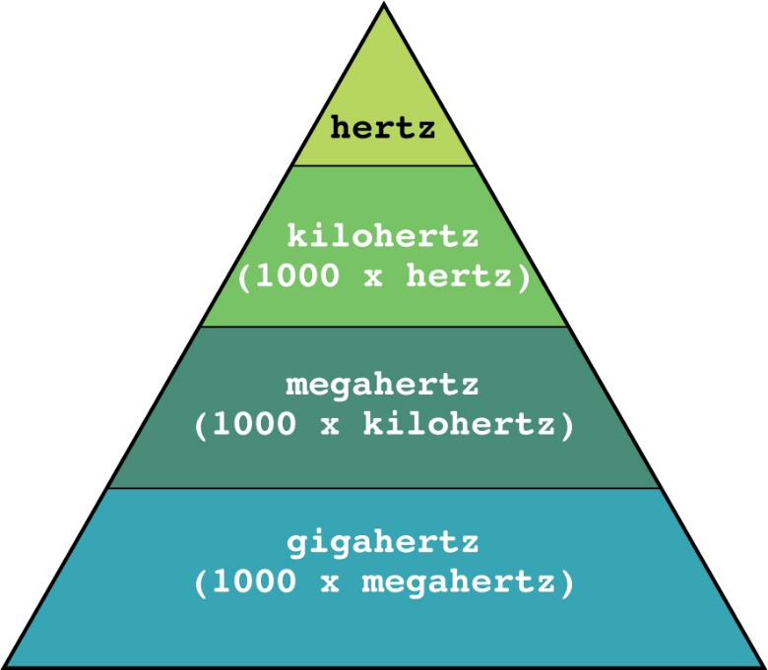
Converting units of speed
You can also convert different units of speed so you can compare the performance of different hardware.
1 megahertz = 1,000 kilohertz = 1,000,000 hertz (1000 x 1000)
5 megahertz = 5,000 kilohertz = 5,000,000 hertz (5 x 1000 x 1000)
1,000,000,000 hertz = 1,000,000 kilohertz = 1,000 megahertz = 1 gigahertz
6,000,000,000 hertz = 6,000,000 kilohertz = 6,000 megahertz = 6 gigahertz

Slide 12
Activity 2.3: Computer performance
Complete worksheets given.
WRITE YOUR NAME ON IT
And give them to teacher

Slide 13
Why does hardware performance matter?
Hardware performance matters because you want your computer to do exactly what you need it to do. However, different people have different requirements.
A gamer wants a fast CPU so their computer plays the latest games smoothly. They also want a powerful graphics card and lots of RAM.
A teacher does not need a particularly powerful computer, so CPU speed is less important, but they want lots of storage space to store all the resources for their lessons.

Slide 14
Computer peripherals
A peripheral is a device that allows information to be entered into or retrieved from a computer.
Peripherals are normally split into different three types:
input devices: devices that allow the user to enter data into a computer
output devices: devices that allow the user to display the results after processing
external storage devices: an external device that stores data.

Slide 15
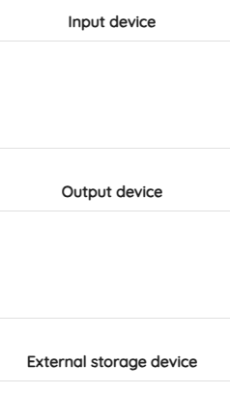
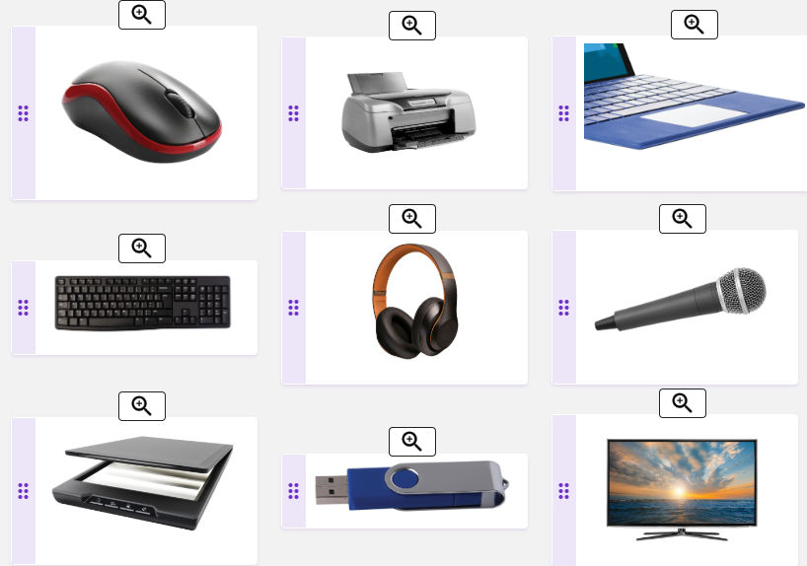
Activity: Categorising peripherals
Categorise each peripheral as an input device, an output device or an external storage device to the correct category.

Slide 16

Is a touchscreen an input device or an output device?

Slide 17
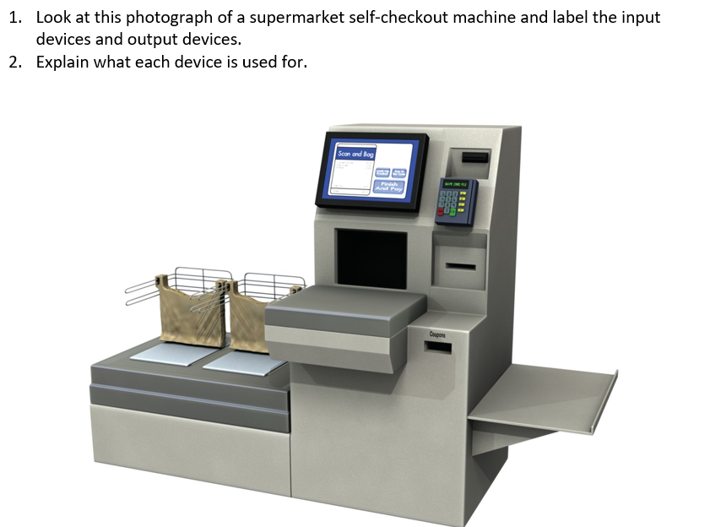
Activity 3.2: Input and output

Slide 18
Data input
There are a large number of input devices. Each one enables data to be entered into a computer so that it can be processed by the computer.
Data can be input in different ways, including:
text typed
images scanned
voices recorded.

Slide 19
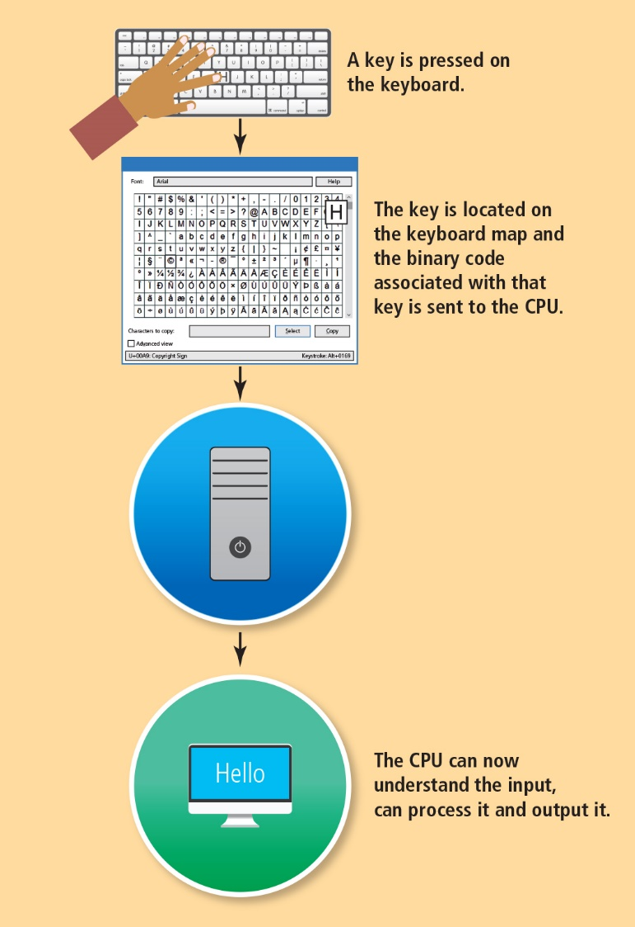
Text typed using a keyboard is the most common form of input

Slide 20
Activity 3.3: Processing input
Complete worksheets given.
WRITE YOUR NAME ON IT
And give them to teacher

